Slide 1

Capstone Project(EDA) Play Store App Review Team Members Chandrashekhar Chaudhari Kishore Yamali

Slide 2
Introduction.
The objective of this project is to deliver insights to understand customer demands better and thus help developers to popularize the product.
The dataset is chosen from alma better. It is of 10k+ Play Store apps for analyzing the Android market.
This dataset contains details of different applications and reviews from different users.
The Play Store apps data has enormous potential to drive app-making businesses to success.

Slide 3
Visualization steps.
Total number of Apps on each category.
Top 10 installed apps form play store.
Top 10 apps with positive reviews.
Type to reviews given users in play store.
Content Ratings of Age Groups.
Top 3 most reviewed apps on play store.
Types of apps which are free or paid.

Slide 4
Steps involved in this project as follows.
Import the required libraries
Load the csv files from google drive
Basic data information
Cleaning the Data
Merging two dataset
Data Visualization
Conclusion

Slide 5
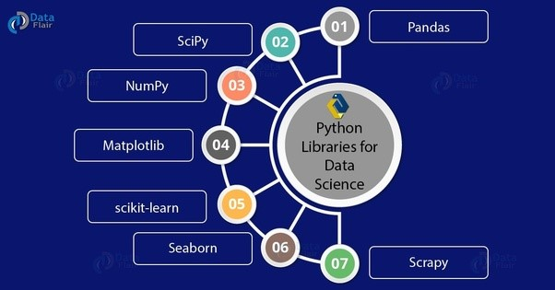
Import the required libraries
import numpy as np
import pandas as pd
import matplotlib.pyplot as plt
%matplotlib inline
import seaborn as sns

Slide 6
Import the required libraries
import NumPy as np - NumPy is a general-purpose array-processing package. It provides a high-performance multidimensional array object, and tools for working with these arrays.
import pandas as pd - Pandas is usually imported under the pd alias. alias: In Python alias are an alternate name for referring to the same thing. Now the Pandas package can be referred to as pd instead of pandas
import matplotlib.pyplot as plt - Matplotlib. pyplot is a collection of command style functions that make matplotlib work like MATLAB. Each pyplot function makes some change to a figure: e.g., creates a figure, creates a plotting area in a figure, plots some lines in a plotting area, decorates the plot with labels, etc.
import seaborn as sns - Seaborn portion of the code tells Python to bring the Seaborn library into your current environment. The as sns portion of the code then tells Python to give Seaborn the alias of sns. This allows you to use Seaborn functions by simply typing sns. function name rather than seaborn.

Slide 7
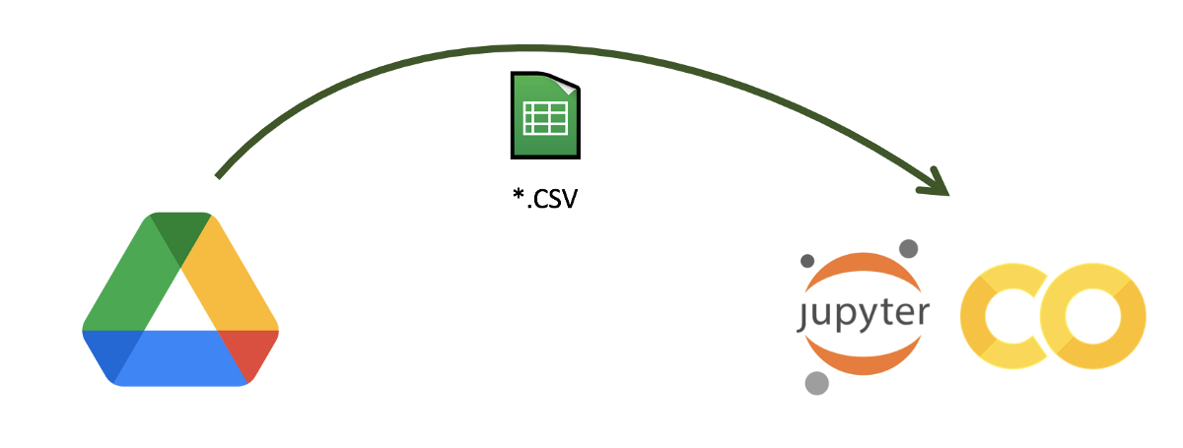
Load the csv files from google drive.
Here we are importing a .csv file. Form Google Drive to Google colab.

Slide 8
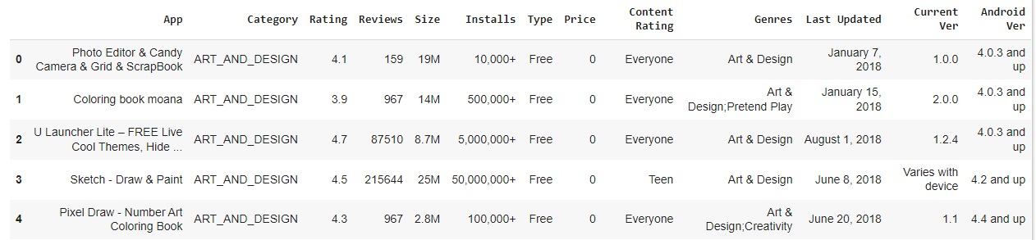
Data Frame .
We have tow data frames.
Play store data frame & Users Review Data frame.
First data frame is play store Data.
Play store data frame has 10841 rows and 13 columns.

Slide 9
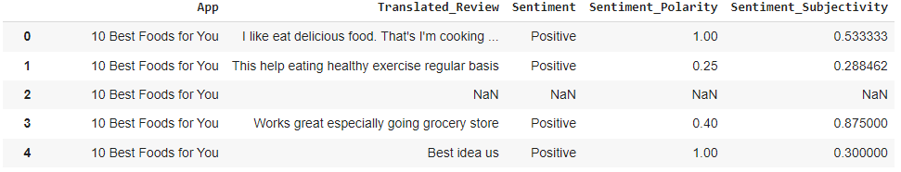
Data Frame .
Second data frame is User Reviews Data .
Users Reviews Data frame has 64295 rows and 5 columns.

Slide 10
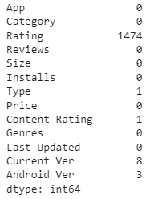
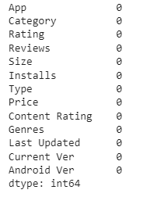
Data Cleaning
Before Cleaning
After Cleaning
On going through the preliminary information's we have found that in both datasets there are some columns which needs to be we converted into appropriate data type for the analyzation. Also, there are null values in some columns which need to be drop.

Slide 11
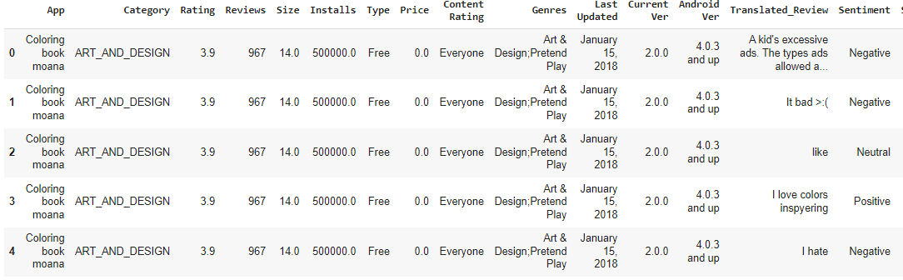
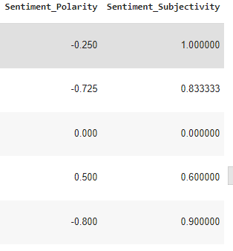
Merging two dataset.
Merging two dataset first Play store Dataset and second user Review Dataset .

Slide 12
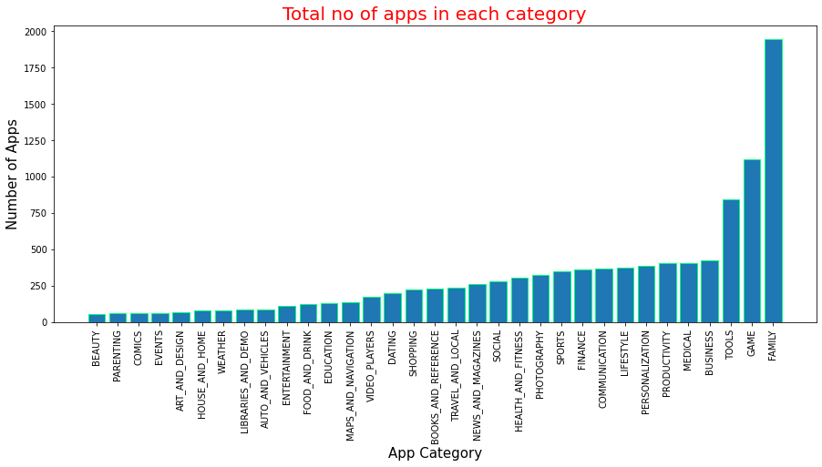
Total Number of Apps on Each Category.
From the above graph we can clearly say that apps of family category are highest and of beauty are the lowest in the playstore

Slide 13
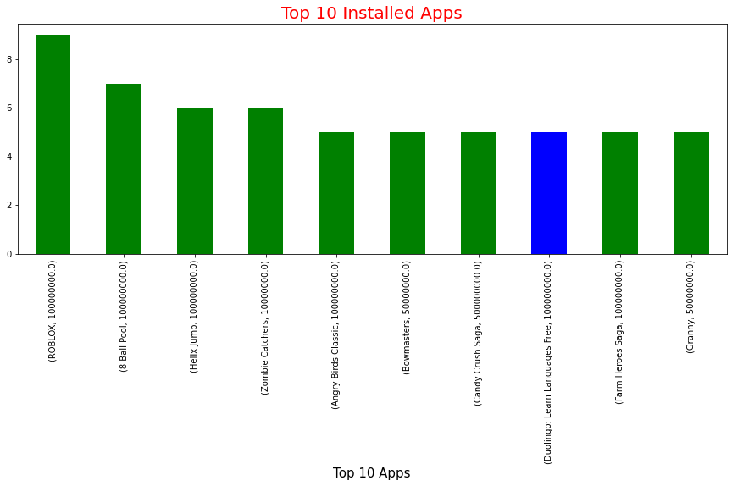
Top 10 Installed Apps from Play store
From the above graph we can clearly see the top 10 apps installed from play store and also we can say that Roblox is the highest installed app and there is only one app which belongs to learning category in top 10 apps and most of the remaining apps belongs to games category in play store.

Slide 14
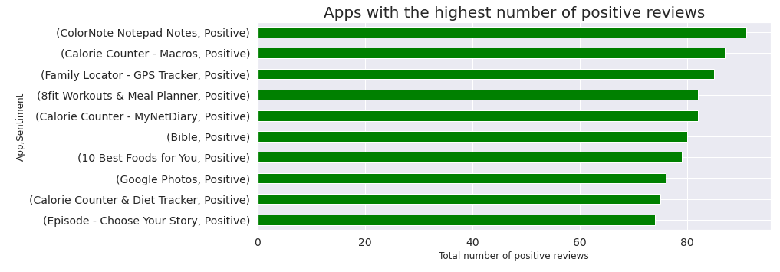
The Top 10 Positive Review Apps.
we can say that ColorNotepad Notes has got highest positive reviews on the play store.

Slide 15
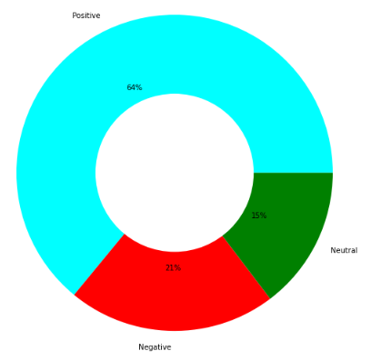
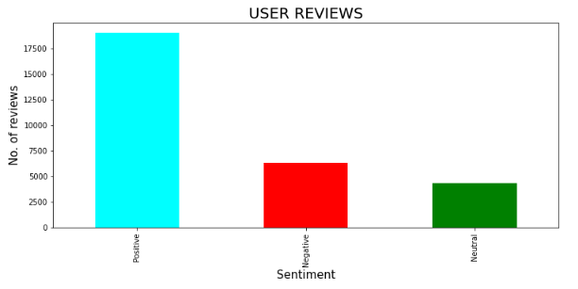
Types of reviews given by users in play store.
From the above graphs we can conclude the values of each content ratings and also we can say that playstore has more number of positive ratings of 64% with 17500+ given by the users and has only 21% negative ratings in playstore.

Slide 16
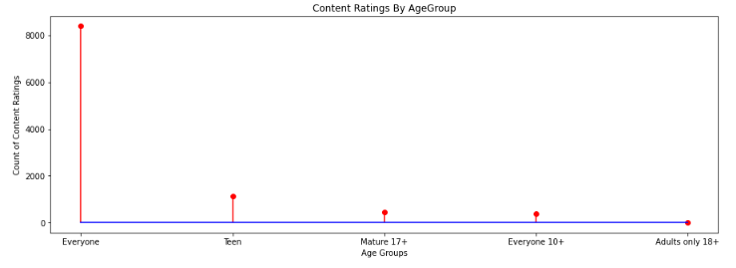
Content Ratings of Age Groups
By seeing this graph we can clearly conclude that content ratings of group everyone is highest in the play tore with 8000+ ratings and the ratings given by age group Adults only 18+ is least with only 3 ratings in the play store.

Slide 17
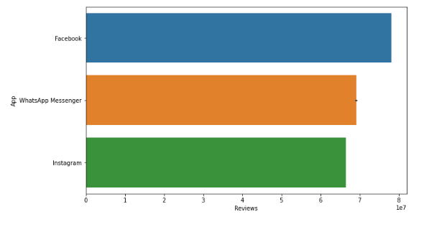
Top 3 Most Reviewed Apps On Play store.
The above graph we can say that Facebook is the highest reviewed application followed by WhatsApp messenger and Instagram in play store.

Slide 18
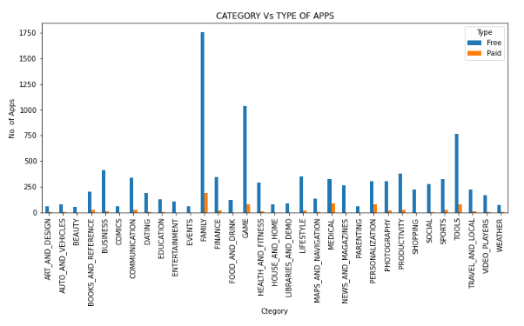
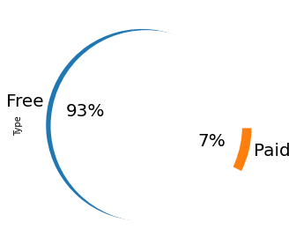
Type Of Apps Which Are Free OR Paid
Percentage of type of apps
No of apps in each category

Slide 19
Conclusion.
We have reached at the end of our EDA. We have gone through both datasets and made them ready for the analyzation. Later we performed EDA by statistical measures and using visualizing tools.
We have provided all important top performing features like - Category, Content Rating, Size and type which is required for the development of App. We also discovered apps which are having most comments of positive sentiment than negative sentiments and neutral sentiments.
To complete this EDA project we use different types of python libraries. (Pandas, NumPy, Matplotlib.pyplot and Seaborn etc.) Throughout complete this project we use and implement various concepts we already taught.
Inspection and exploration of the data frames and checking the data type available in provided data frame.
Executing various python function and different libraries operation to change data values and convert into required data form.
Using various data visualization function and methods for the projection of summarized information from the data frame via whom anyone can easily understand and explain the outputs.

Slide 20


